Slide 1
Characterizing cancer for better understanding

Slide 2
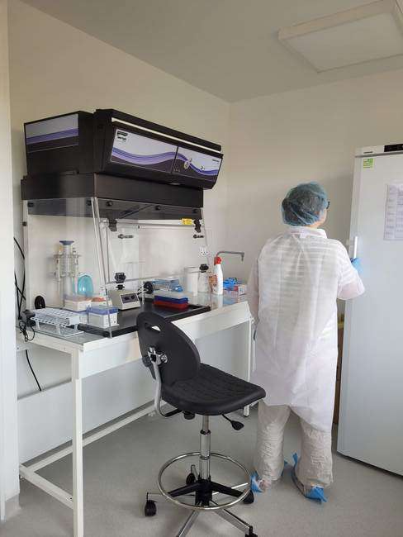
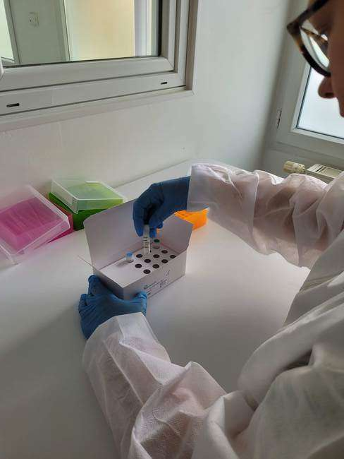
Genexpath
Specialized in non-hodgkin lymphomas and
sarcomas characterization
CE IVD marked
Certification ISO 13 485:2016

Slide 3
Our goal
A better characterization of cancer
for
A better understanding

Slide 4
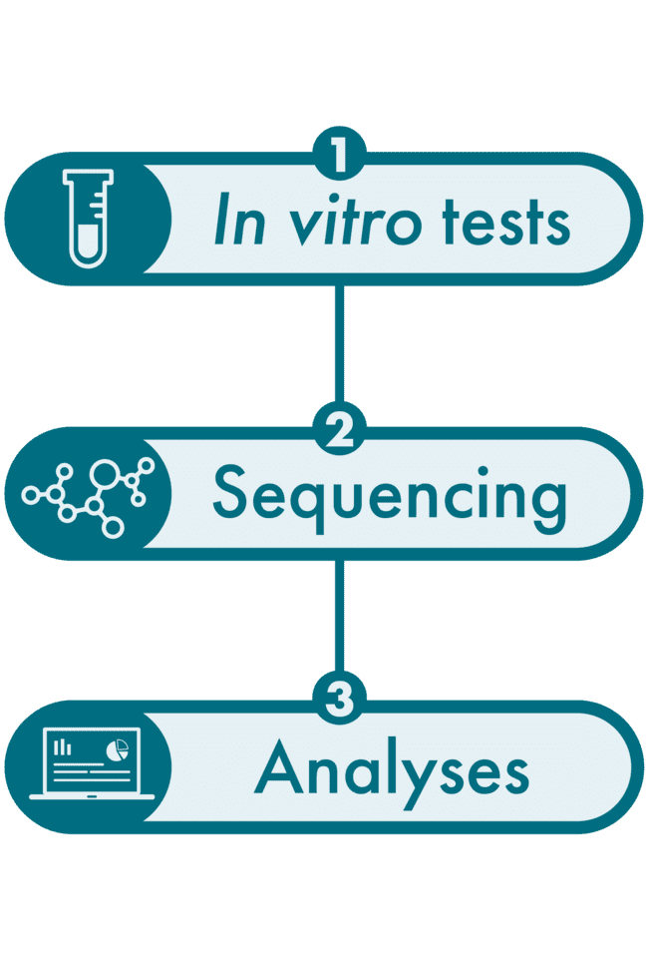
How?
By offering turnkey solutions
from bench to bioinformatics analysis of data
The technique:
RT-MLPSeq (RT-MLPA + NGS)

Slide 5
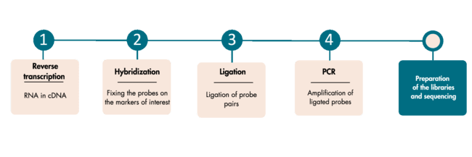
1
In vitro test (RT-MLPA)
A multi-step in vitro test which evaluates simultaneously several genetic markers (genes, mutations, chromosomal translocations…)

Slide 6
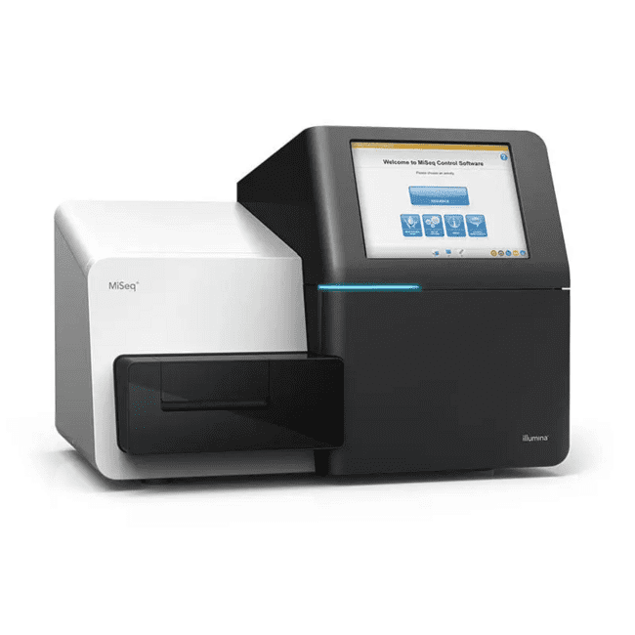
2
Sequencing
Illumina MiSeq or NextSeq.
100 000 reads per sample.
Possibility to mix Genexpath Libraries with other libraries and to complete flowcells.
Possibility to analyze only 1 sample.
Allows you to generate a FASTQ file

Slide 7
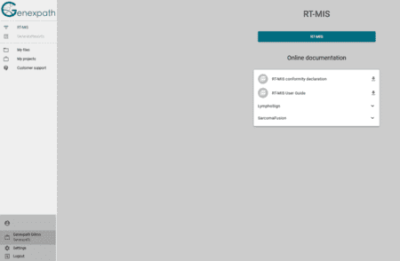
3
Bioinformatics analysis on our RT-MIS platform
GENEXPATH RT-MIS allows the loading of FASTQ file.
It will carry out demultiplexing to assign sequences to each sample.
RT-MIS generates a report for each sample to help the user in data analysis (can be downloaded).

Slide 8
Our products
Classification of NHL according to the WHO classification
- Gene expression signature
LymphoSign Test
SarcomaFusion Test
Detection of fusion transcripts involved sarcoma
Detection of fusion transcripts involved in peripheral
T-Cells Lymphomas
LymphoTranscript Test
Gene expression signature on 10 to 100 markers of
interest that you choose
CustomPanel

Slide 9
LymphoTranscript
Detection of fusion transcripts involved in peripheral
T-Cells Lymphomas
LymphoTranscript Test
Detection of 50 fusion transcripts identified in peripheral T-Cells Lymphomas
Links to scientific publications referring to the identified fusion transcripts

Slide 10
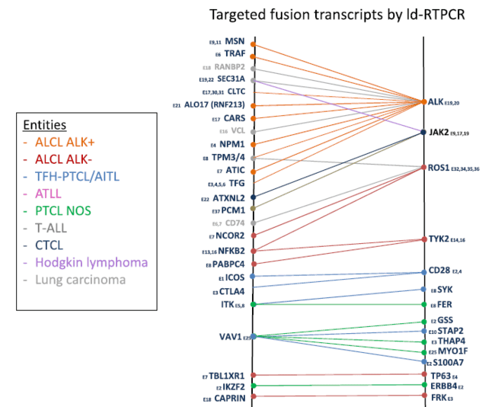
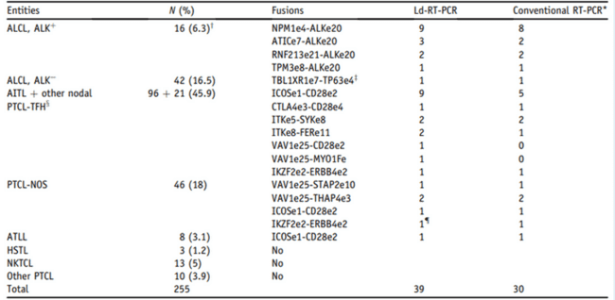
Proof of concept: Drieux and al. Mol Diagn (2021)
Drieux and al. J Mol Diagn (2021)

Slide 11
Fusion transcripts detected

Slide 12
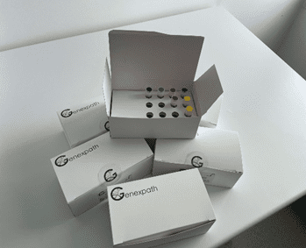
Genexpath sets
Set contains:
Probes mix for RT-MLPA
Genexpath barcodes
Genexpath sequencing primers
Access to the bioinformatics platform
Sets are available for 8, 16 or 24

Slide 13
Usual laboratory techniques
SIMPLE
Inexpensive and analysis bioinformatics included
Requires ¹/₂ day of manipulation
LOW COST
FAST
Characteristics
Thanks to UMI
Access to complete
raw data
RELIABLE
TRANSPARENCY
Low RNA quantity needed
SIGNIFICANT SENSITIVITY

Slide 14
Thank you for your attention

