Slide 1



Characterizing cancer for better understanding

Slide 2

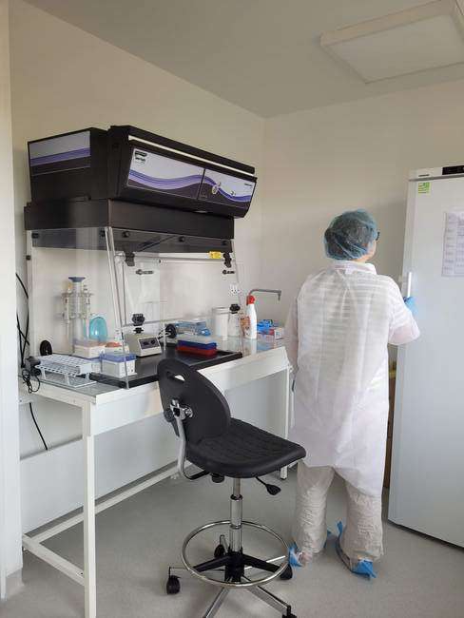

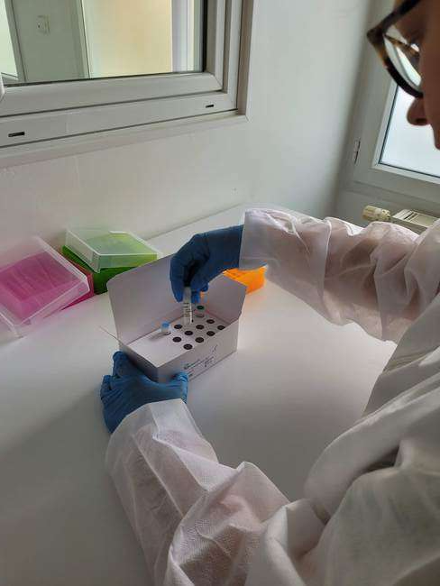

Genexpath
Specialized in non-hodgkin lymphomas and
sarcomas characterization
CE IVD marked
Certification ISO 13 485:2016

Slide 3
Our goal
A better characterization of cancer
for
A better understanding

Slide 4
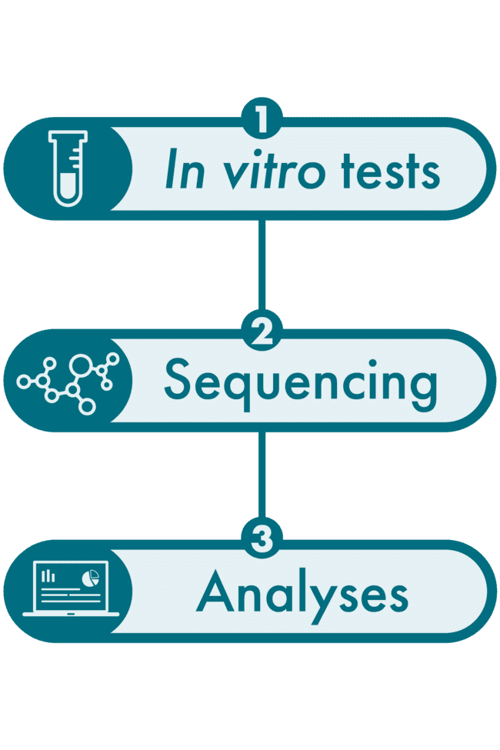

How?
By offering turnkey solutions
from bench to bioinformatics analysis of data
The technique:
RT-MLPSeq (RT-MLPA + NGS)

Slide 5
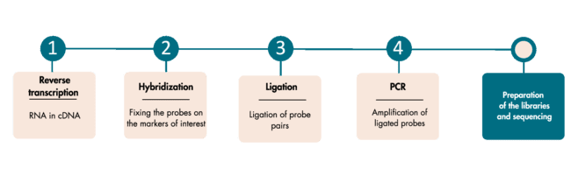
1
In vitro test (RT-MLPA)
A multi-step in vitro test which evaluates simultaneously several genetic markers (genes, mutations, chromosomal translocations…)

Slide 6


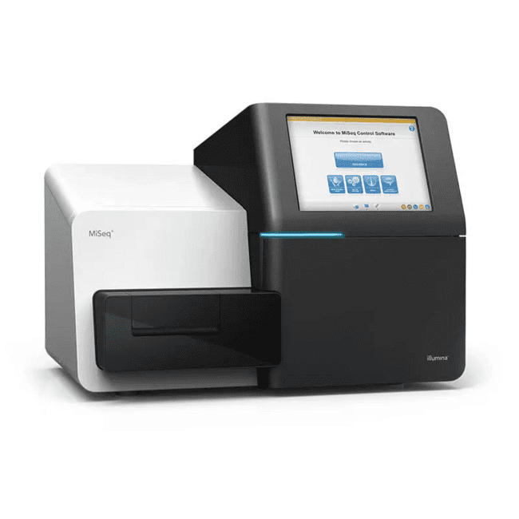
2
Sequencing
Illumina MiSeq or NextSeq.
100 000 reads per sample.
Possibility to mix Genexpath Libraries with other libraries and to complete flowcells.
Possibility to analyze only 1 sample.
Allows you to generate a FASTQ file

Slide 7

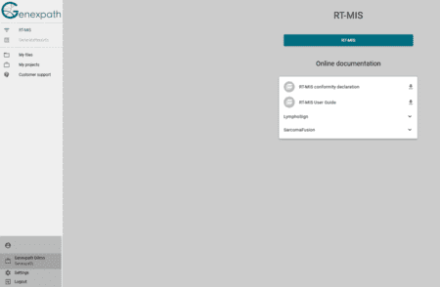



3
Bioinformatics analysis on our RT-MIS platform
GENEXPATH RT-MIS allows the loading of FASTQ file.
It will carry out demultiplexing to assign sequences to each sample.
RT-MIS generates a report for each sample to help the user in data analysis (can be downloaded).

Slide 8


Our products
Classification of NHL according to the WHO classification
- Gene expression signature
LymphoSign Test
SarcomaFusion Test
Detection of fusion transcripts involved in sarcomas
Detection of fusion transcripts involved in peripheral
T-Cells Lymphomas
LymphoTranscript Test
Gene expression signature on 10 to 100 markers of
interest that you choose
CustomPanel

Slide 9
SarcomaFusion
SarcomaFusion Test
Detection of fusion transcripts involved in sarcomas
Finding 140 fusion transcripts identified in sarcomas
Referenced publications linked to the detection results from fusion transcripts
Links to publications referring to detected fusion transcripts

Slide 10
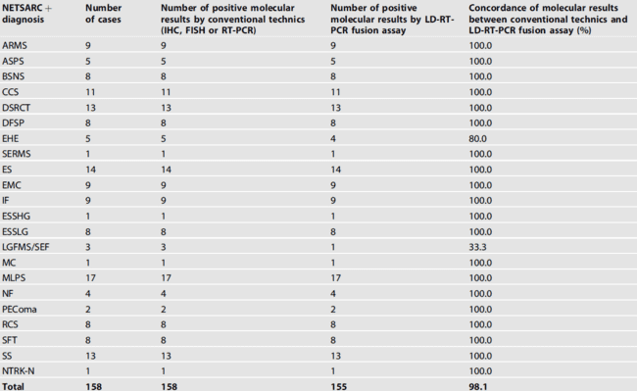
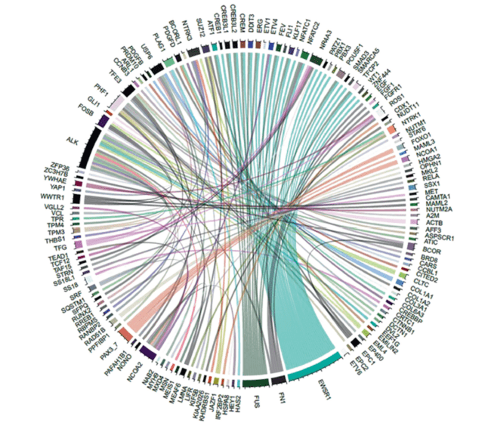
Proof of concept: Lanic and al. Mod Pathol 2022
Lanic and al. Mod Pathol (2022)

Slide 11
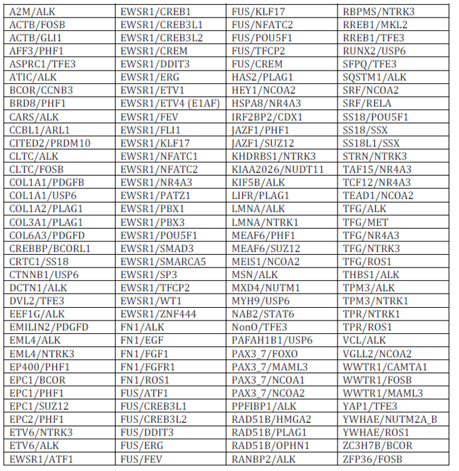
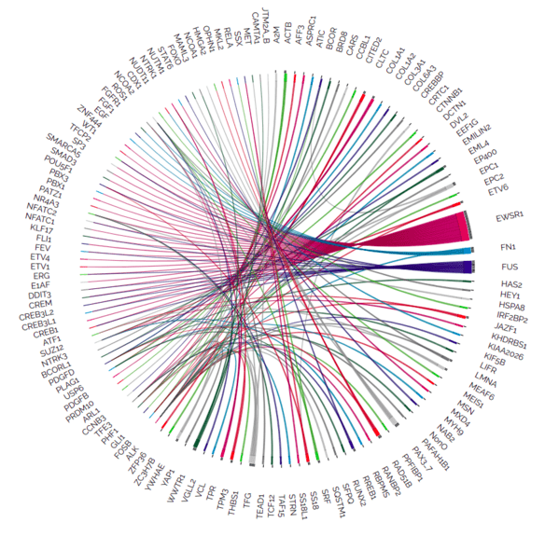
Fusion transcripts detected

Slide 12

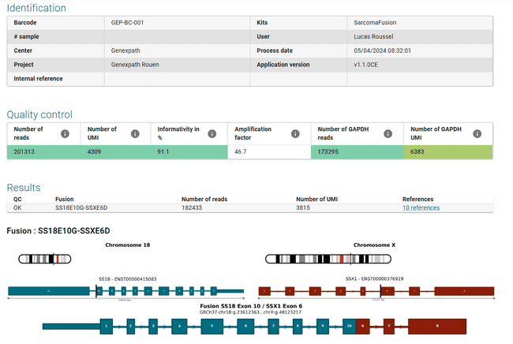

RT-MIS report
Identification: Analysis of characteristics
Quality control:
Number of reads (for sample and GAPDH)
Number of UMI (for sample and GAPDH)
Results:
Detected fusion
Raw data
Bibliographical references to the fusion associated to a sarcoma
All raw data available in CSV file

Slide 13
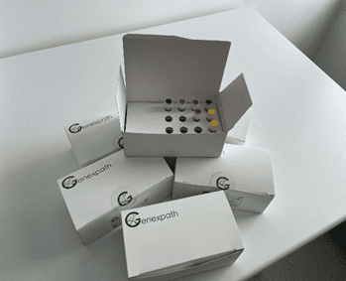

Genexpath sets
Set contains:
Probes mix for RT-MLPA
Genexpath barcodes
Genexpath sequencing primers
Access to the bioinformatics platform
Sets are available for 8, 16, 24 or 48 analyses

Slide 14

Usual laboratory techniques
SIMPLE
Inexpensive and analysis bioinformatics included
Requires ¹/₂ day of manipulation
LOW COST
FAST
Characteristics
Thanks to UMI
Access to complete
raw data
RELIABLE
TRANSPARENCY
Low RNA quantity needed
SIGNIFICANT SENSITIVITY

Slide 15
Thank you for your attention

